Slide 1


Week 4
1

Slide 2
Index
2
Sr no | index
1 | Week4Sketch1
2 | Week4Sketch2
Sr. no
1
2
3
4
5
Contents
Week1Sketch1
Week1Sketch2 Week1Assignment1
Week1Assignment2 Insights

Slide 3
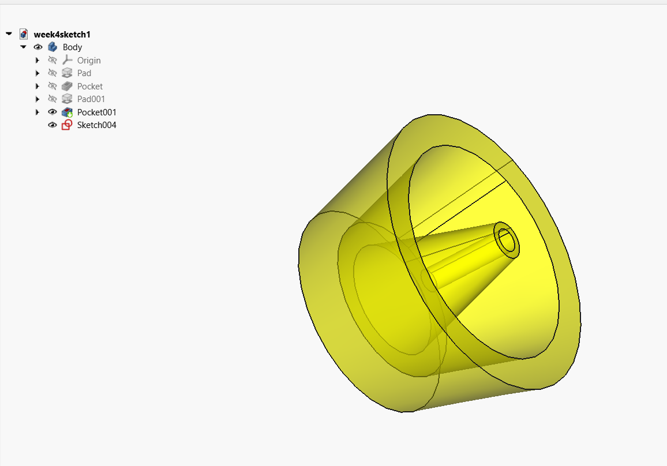
Week4Sketch1

Slide 4
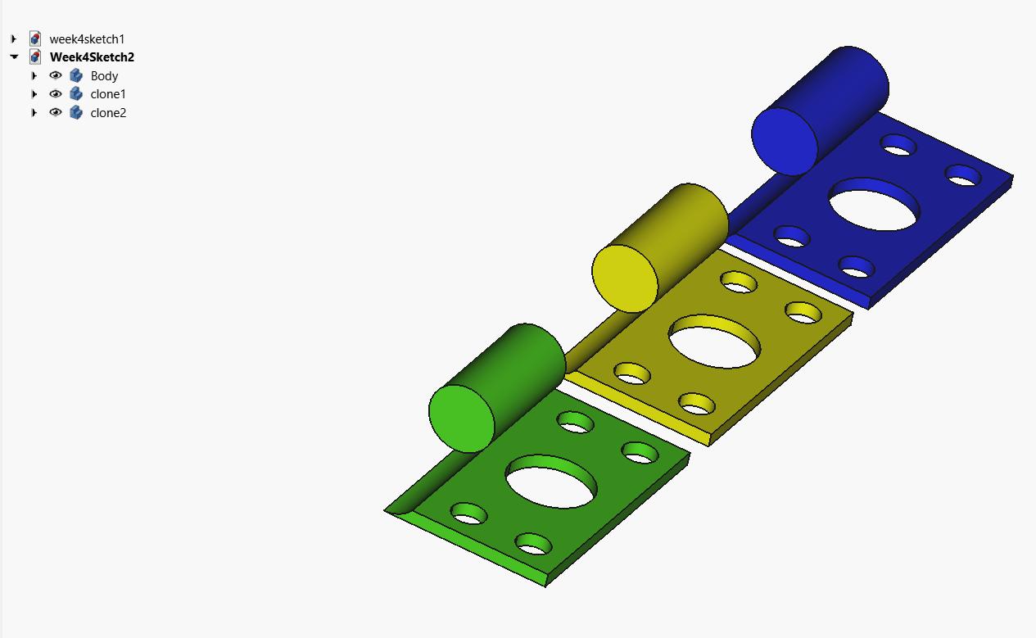
Week4Sketch2

Slide 5
Insights
Learn about Revolved tool
Learn about Pad,Pocket and taper view
Thinking about tolerances (preesfit)
Learn about clone tool
Difrrence between Copy paste and cloning

